Slide 1





SEC 10K-Filings
Preprocessed Documents
-> Removing HTML-Attributes, Empty HTML Tags, XBLR Tags
Splitted Documents
-> Recursive Character Text Splitter based on HTML (Chunk Length = 6,000 chars; Overlap = 10 %)
Embeddings
-> Snowflake Arctic-embed-m-v1.5
Qdrant Collection
-> Local Docker Instance
Sharing ID
Store Full Documents
-> Right now on Disk, but maybe Database?

Slide 2




Full Documents
Preprocessed Documents
Transformed Documents
Document Chunking
Chunk Embeddings
Vector Store
Table Extraction
Table Serialization

Slide 3
Full Documents
Preprocessed Documents
Transformed Documents
Document Chunking
Chunk Embeddings
Vector Store
Table Extraction
Table Serialization

Slide 4
Full Documents
Preprocessed Documents
Document Chunking
Chunk Embeddings
Vector Store

Slide 5
Full Documents
Preprocessed Documents
Document Chunking
Chunk Embeddings
Vector Store

Slide 6
Indexing Vanilla RAG
Indexing
Table QA Framework

Slide 7

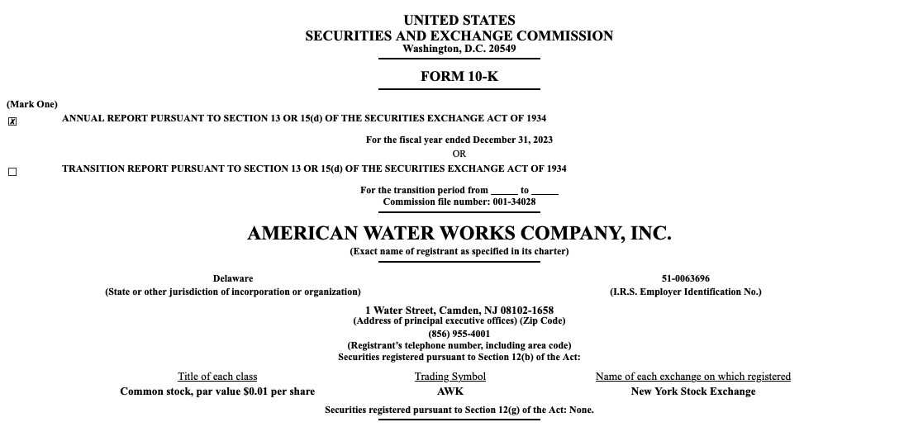
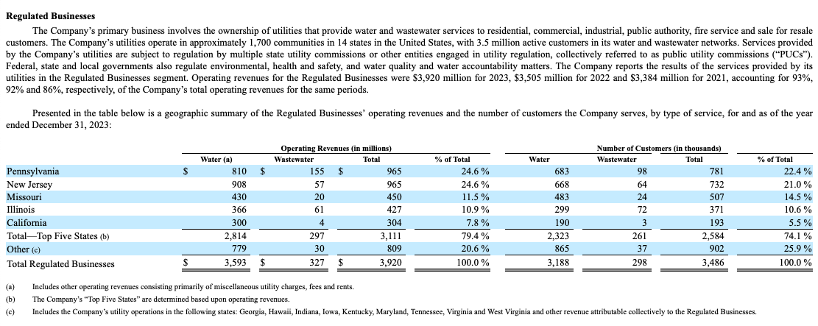
Document Corpus
Unit Elements
…
…

Slide 8

Document Corpus
Relevant Chunk

Slide 9

Question
What is the age of the youngest student?
Document

Slide 10
Document

Slide 11

Serialized Chunk
Question
What is the age of the youngest student?
<table>
<thead>
<tr>
<th colspan="7">grades</th>
</tr>
...
</thead>
<tbody>
...
</tbody>
</table>
Answer
16

Slide 12
Initial Chunk

Slide 13
Relevant Chunk

Slide 14
Relevant Chunk

Slide 15
Question
What is the age of the youngest student?
Chunk Serialization
Answer
16

Slide 16

Question
What is the age of the youngest student in the ‚Science College‘?
Answer
16
Documents
Table QA Framework
Incl. Table Serialization

Slide 17
Question
What is the age of the youngest student?
Chunk
Retrieval
Answer
16

Slide 18
Question
What is the age of the youngest student?
Chunk
Retrieval
Chunk
Serialization
Answer
16

Slide 19
Document
Chunks
…
…
…
…

Slide 20


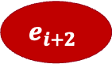


Document
$$e_{1}$$
Text
…
…
$$e_{i}$$
$$e_{i+1}$$
…
…
$$e_{i+2}$$

Slide 21
Table
$$e_{1}$$
Text
…
…
$$e_{i}$$
$$e_{i+1}$$
…
…
$$e_{i+2}$$

Slide 22
j = 1
j = 2
j = 3
j = 4
j = 5
j = 6
j = 7
i = 1
grades
 |  |  | 2023 |  | 2024
class | name | age | math | english | math | english
A | John | 17 | A | C | A | B
 | Tiffany | 16 | B | B | C | B
B | Michael | 17 | D | D | D | D
i = 2
i = 3
i = 4
i = 5
i = 6

Slide 23
Initial Table
j = 1
j = 2
j = 3
j = 4
j = 5
j = 6
j = 7
i = 1
grades
 |  |  | 2023 |  | 2024
class | name | age | math | english | math | english
A | John | 17 | A | C | A | B
 | Tiffany | 16 | B | B | C | B
B | Michael | 17 | D | D | D | D
i = 2
i = 3
i = 4
i = 5
i = 6

Slide 24
j = 1
j = 2
j = 3
j = 4
Column Header Cell
j = 5
j = 6
j = 7
i = 1
grades
 |  |  | 2023 |  | 2024
class | name | age | math | english | math | english
A | John | 17 | A | C | A | B
 | Tiffany | 16 | B | B | C | B
B | Michael | 17 | D | D | D | D
i = 2
i = 3
i = 4
i = 5
i = 6
Context-Intersection Cell
Row Label Cell
Value Cell

Slide 25
j = 1
j = 2
j = 3
j = 4
j = 5
j = 6
j = 7
i = 1
grades |  | grades
 |  |  | 2023 |  | 2024
class | name | age | math | english | math | english
A | John | 17 | A | C | A | B
 | Tiffany | 16 | B | B | C | B
B | Michael | 17 | D | D | D | D
i = 2
i = 3
i = 4
i = 5
i = 6

Slide 26
j = 1
j = 2
j = 3
j = 4
j = 5
j = 6
j = 7
i = 1
grades
 |  |  | 2023 |  | 2024
class | name | age | math | english | math | english
A | John | 17 | A | C | A | B
 | Tiffany | 16 | B | B | C | B
B | Michael | 17 | D | D | D | D
i = 2
i = 3
i = 4
i = 5
i = 6

Slide 27
<table>
<thead>
<tr>
<th colspan="7">grades</th>
</tr>
<tr>
<th></th><th></th><th></th>
<th colspan="2">2023</th>
<th colspan="2">2024</th>
</tr>
<tr>
<th>class</th>...<th>english</th>
</tr>
</thead>
<tbody>
<tr>
<td rowspan="2">A</td>
<td>John</td>
...
<td>B</td>
</tr>
...
</tbody>
</table>
grades
 |  |  | 2023 |  | 2024
class | name | age | math | english | math | english
A | John | 17 | A | C | A | B
 | Tiffany | 16 | B | B | C | B
B | Michael | 17 | D | D | D | D

Slide 28
Full Table
1-Range
2-Range
You are tasked with analyzing table data to determine whether the provided row should be classified as a row label or not.
Instructions:
…
Row to analyze:
[‘class’, ‘name’, ‘age’, ‘math’, ‘english’, ‘math’, ‘english’]
The full table is the following:
<table>
<thead>
<tr>
<th colspan="7">grades</th>
</tr>
...
</table>
You are tasked with analyzing table data to determine whether the provided row should be classified as a row label or not.
Instructions:
…
Row to analyze:
[‘class’, ‘name’, ‘age’, ‘math’, ‘english’, ‘math’, ‘english’]
The previous row is the following:
[‘’,’’,’’,’2023’,’2023’,’2024’,’2024’]
The next row is the following:
[‘A’,’John’,’17’,’age’,’A’,’C’,’A’,’B’]
You are tasked with analyzing table data to determine whether the provided row should be classified as a row label or not.
Instructions:
…
Row to analyze:
[‘class’, ‘name’, ‘age’, ‘math’, ‘english’, ‘math’, ‘english’]
The previous row is the following:
[‘’,’’,’’,’2023’,’2023’,’2024’,’2024’]
The second previous row is the following:
[‘grades’,‘grades’, ..., ‘grades’]
The next row is the following:
[‘A’,’John’,’17’,’A’,’C’,’A’,’B’]
The second next row is the following:
[‘A’,’Tiffany’,’16’,’B’,’B’,’C’,’B’]

Slide 29
Column Header Tree as Primary Subtree
Row Label Tree as Primary Subtree
grades:
age:
- A > John: 17
- A > Tiffany: 16
- B > Michael: 17
2023:
math:
- A > John: A
- A > Tiffany: B
- B > Michael: D
english:
- A > John: C
- A > Tiffany: B
- B > Michael: D
2024:
math:
...
english:
...
A:
John:
grades > age: 17
grades > 2023 > math: A
grades > 2023 > english: C
grades > 2024 > math: A
grades > 2024 > english: B
Tiffany:
grades > age: 17
grades > 2023 > math: B
grades > 2023 > english: B
...
B:
Michael:
grades > age: 17
grades > 2023 > math: D
grades > 2023 > english: D
...

Slide 30

$${root}^{c}$$
grades
grades
2023
2024
class
name
age
math
english
math
english
17
16
17
A
B
D
C
B
D
A
C
D
B
B
D

Slide 31
$${root}^{c}$$
grades
grades
2023
2024
class
name
age
math
english
math
english
17
16
17
A
B
D
C
B
D
A
C
D
B
B
D

Slide 32
$${root}^{c}$$
grades
grades
2023
2024
class
name
age
math
english
math
english

Slide 33

$${root}^{r}$$
class
A
B
grades
name
John
Tiffany
Michael
17
16
17
A
B
D
C
B
D
A
C
D
B
B
D

Slide 34
$${root}^{r}$$
class
A
B
grades
name
John
Tiffany
Michael
17
16
17
A
B
D
C
B
D
A
C
D
B
B
D

Slide 35

$${root}^{r}$$
class
A
B
grades
name
John
Tiffany
Michael

Slide 36
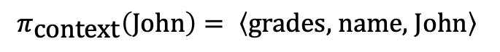
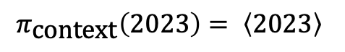
Column Header Tree as Primary Subtree
Row Label Tree as Primary Subtree
$$π_{\text{context}}\left(2023\right)= \left\langle 2023\right\rangle$$
$$π_{\text{context}}\left(\text{John}\right)= \left\langle \text{grades}\text{, }\text{name}\text{, }\text{John}\right\rangle$$

Slide 37
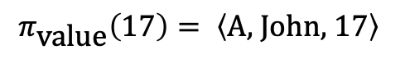
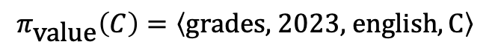
Column Header Tree as Secondary Subtree
Row Label Tree as Secondary Subtree
$$π_{\text{value}}\left(C\right)=\left\langle \text{grades}\text{, 2023, }\text{english},\text{C}\right\rangle$$
$$π_{\text{value}}\left(\text{17}\right)= \left\langle \text{A}\text{, }\text{John}\text{, }17\right\rangle$$

Slide 38
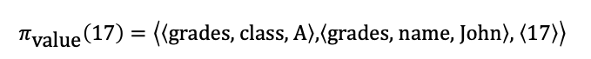
Column Header Tree as Secondary Subtree
Row Label Tree as Secondary Subtree
$$π_{\text{value}}\left(C\right)=\left\langle \left\langle \text{grades}\right\rangle \text{, }\left\langle \text{2023}\right\rangle \text{, }\left\langle \text{class}\text{, }\text{name}\text{, }\text{english}\right\rangle ,\left\langle \text{C}\right\rangle \right\rangle$$
$$π_{\text{value}}\left(\text{17}\right)=\left\langle \left\langle \text{grades}\text{, }\text{class}\text{, }\text{A}\right\rangle \text{,}\left\langle \text{grades}\text{, }\text{name}\text{, }\text{John}\right\rangle \text{, }\left\langle 17\right\rangle \right\rangle$$

Slide 39


${ T}_{1}$ |
Column Header Tree as Primary Subtree
Context String
Base:
2023:
The column header 2023 has siblings 2024. The children of 2023 are math, english.
Text-Augmentation:
${ T}_{1}$ |
Row Label Tree as Primary Subtree
Context String
Base:
John:
The row label John has siblings Tiffany, Michael.
Text-Augmentation:

Slide 40


${ T}_{1}$ |
Column Header Tree as Primary Subtree
Context String
Base:
2023:
The column header 2023 has siblings 2024. The children of 2023 are math, english.
Text-Augmentation:
${ T}_{1}$ |
Row Label Tree as Primary Subtree
Context String
Base:
grades & name & John:
The row label John represents grades, names. It has the following siblings: Tiffany, Michael. The values of John are:
Text-Augmentation:

Slide 41
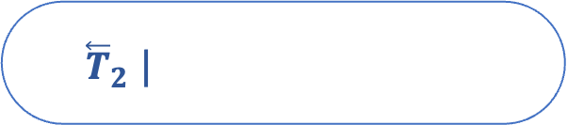

${ \overset{⃖}{T}}_{2}$ |
Column Header Tree as Secondary Subtree
Value String
Base:
grades > 2023 > english: C
The value of the column header combination grades, 2023, english is C.
Text:
The value of the column header combination grades, 2023, english and the row label combination A, John is C.
Text-Augmentation:
${ \overset{⃖}{T}}_{2}$ |
Row Label Tree as Secondary Subtree
Value String
Base:
A > John: 17
The value of the row label combination A, John is 17.
Text:
The value of the row label combination A, John and the column header combination grades, age is 17.
Text-Augmentation:

Slide 42
${ \overset{⃖}{T}}_{2}$ |
Column Header Tree as Secondary Subtree
Value String
Base:
grades > 2023 > class & name & english: C
The value of the column header combination grades, 2023, class & name & english is C.
Text:
The value of the column header combination grades, 2023, class & name & english and the row label combination grades & class & A, grades & name & John is C.
Text-Augmentation:
${ \overset{⃖}{T}}_{2}$ |
Row Label Tree as Secondary Subtree
Value String
Base:
grades & class & A > grades & name & John: 17
The value of the row label combination grades & class & A, grades & name & John is 17.
Text:
The value of the row label combination grades & class & A, grades & name & John and the column header combination grades, class & name & age is 17.
Text-Augmentation:

Slide 43


$${root}^{r}$$
class
A
B
grades
name
John
Tiffany
Michael
17
16
17
A
B
D
C
B
D
A
C
D
B
B
D
age
grades
$${root}^{c}$$

Slide 44

$${root}^{r}$$
class
A
B
grades
name
John
Tiffany
Michael
17
16
17
A
B
D
C
B
D
A
C
D
B
B
D

Slide 45
$${root}^{r}$$
class
A
B
grades
name
John
Tiffany
Michael
17
16
17
A
B
D
C
B
D
A
C
D
B
B
D

Slide 46
$${root}^{r}$$
class
A
B
grades
name
John
Tiffany
Michael
17
16
17
A
B
D
C
B
D
A
C
D
B
B
D
age
grades
$${root}^{c}$$

Slide 47


$${root}^{c}$$
grades
grades
2023
2024
class
name
age
math
english
math
english
17
16
17
A
B
D
C
B
D
A
C
D
B
B
D
John
A
$${root}^{r}$$

Slide 48

$${root}^{c}$$
grades
grades
2023
2024
class
name
age
math
english
math
english
17
16
17
A
B
D
C
B
D
A
C
D
B
B
D

Slide 49
$${root}^{c}$$
grades
grades
2023
2024
class
name
age
math
english
math
english
17
16
17
A
B
D
C
B
D
A
C
D
B
B
D

Slide 50
$${root}^{c}$$
grades
grades
2023
2024
class
name
age
math
english
math
english
17
16
17
A
B
D
C
B
D
A
C
D
B
B
D
John
A
$${root}^{r}$$

Slide 51
<table>
<thead>
<tr>
<th colspan="7">grades</th>
</tr>
...
</thead>
<tbody>
...
</tbody>
</table>

Slide 52
grades
 |  |  | 2023 |  | 2024
class | name | age | math | english | math | english
A | John | 17 | A | C | A | B
 | Tiffany | 16 | B | B | C | B
class | name | age | french | physics | french | physics
B | Michael | 17 | D | D | D | D

Slide 53
grades
 |  |  | 2023 |  | 2024
class | name | age | math | english | math | english
A | John | 17 | A | C | A | B
 | Tiffany | 16 | B | B | C | B
class | name | age | math | english | math | english
B | Michael | 17 | D | D | D | D

Slide 54
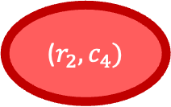
j = 1
j = 2
j = 3
j = 4
j = 5
j = 6
j = 7
i = 1
grades
 |  |  | 2023 |  | 2024
class | name | age | math | english | math | english
A | John | 17 | A | C | A | B
 | Tiffany | 16 | B | B | C | B
B | Michael | 17 | D | D | D | D
i = 2
i = 3
i = 4
i = 5
i = 6
($r_{2},c_{4})$

Slide 55
j = 1
j = 2
j = 3
j = 4
j = 5
j = 6
j = 7
i = 1
grades
 |  |  | 2023 |  | 2024
class | name | age | math | english | math | english
A | John | 17 | A | C | A | B
 | Tiffany | 16 | B | B | C | B
B | Michael | 17 | D | D | D | D
i = 2
i = 3
i = 4
i = 5
i = 6

Slide 56
j = 1
j = 2
j = 3
j = 4
j = 5
j = 6
j = 7
i = 1
grades | grades
 |  |  | 2023 |  | 2024
class | name | age | math | english | math | english
A | John | 17 | A | C | A | B
 | Tiffany | 16 | B | B | C | B
B | Michael | 17 | D | D | D | D
i = 2
i = 3
i = 4
i = 5
i = 6

Slide 57
j = 1
j = 2
j = 3
j = 4
j = 5
j = 6
j = 7
i = 1
grades | grades
 |  |  | 2023 |  | 2024
class | name | age | math | english | math | english
A | John | 17 | A | C | A | B
 | Tiffany | 16 | B | B | C | B
B | Michael | 17 | D | D | D | D
i = 2
i = 3
i = 4
i = 5
i = 6

Slide 58



Split at
$$j^{∗}=2$$
${\tilde{y}}_{14}=(\left[1, 3\right], \left[0, 0\right],“grades“)$ before: $y_{14}=(\left[3, 3\right], \left[0, 0\right],“grades“)$
${\tilde{y}}_{11}=(\left[0, 1\right], \left[0, 0\right],“grades“)$ before: $y_{11}=(\left[0, 6\right], \left[0, 0\right],“grades“)$

Slide 59
Column Headers
Row Labels

Slide 60
grades |  | grades
 |  |  | 2023 |  | 2024
class | name | age | math | english | math | english
A | John | 17 | A | C | A | B
 | Tiffany | 16 | B | B | C | B
B | Michael | 17 | D | D | D | D

Slide 61


$${root}^{c}$$
grades
grades
2023
2024
class
name
age
math
english
math
english
John
Tiffany
Michael
17
16
17
A
B
D
C
B
D
A
C
D
B
B
D
A
B
$${root}^{r}$$

Slide 62

$${root}^{context−inter}$$
grades
grades
2023
2024
A
class
B
name
age
math
english
math
english

Slide 63
$${root}^{context−inter}$$
grades
grades
2023
2024
A
class
name
age
math
english
math
english
B
John
Tiffany
Michael

Slide 64
grades
class

Slide 65

$${root}^{r}$$
A
B
John
Tiffany
Michael
17
16
17
A
B
D
C
B
D
A
C
D
B
B
D

Slide 66
$${root}^{c}$$
grades
2023
2024
name
age
math
english
math
english
John
Tiffany
Michael
17
16
17
A
B
D
C
B
D
A
C
D
B
B
D

Slide 67
Column Header Tree
Row Label Tree

Slide 69


$${root}^{c}$$
grades
grades
2023
2024
class
name
age
math
english
math
english
17
16
17
A
B
D
C
B
D
A
C
D
B
B
D
name
John
Tiffany
Michael
grades
class
A
B
$${root}^{r}$$

Slide 70
$${root}^{c}$$
grades
grades
2023
2024
class
name
age
math
english
math
english
17
16
17
A
B
D
C
B
D
A
C
D
B
B
D
name
John
Tiffany
Michael
grades
class
A
B
$${root}^{r}$$

Slide 71

$${root}^{c}$$
grades
grades
2023
2024
class
name
age
math
english
math
english
17
16
17
A
B
D
C
B
D
A
C
D
B
B
D
John
Tiffany
Michael
A
B
$${root}^{r}$$

Slide 72

$${root}^{c}$$
grades
grades
2023
2024
class
name
age
math
english
math
english
17
16
17
A
B
D
C
B
D
A
C
D
B
B
D

Slide 73

$${root}^{r}$$
class
A
B
grades
name
John
Tiffany
Michael
17
16
17
A
B
D
C
B
D
A
C
D
B
B
D

Slide 74
$${root}^{c}$$
grades
2023
2024
age
math
english
math
english
17
16
17
A
B
D
A
B
D
A
C
D
B
B
D
A
B
$${root}^{r}$$

Slide 76
j = 1
j = 2
j = 3
j = 4
j = 5
j = 6
j = 7
i = 1
grades
 |  |  | 2023 |  | 2024
class | name | age | math | english | math | english
A | John | 17 | A | C | A | B
 | Tiffany | 16 | B | B | C | B
B | Michael | 17 | D | D | D | D
i = 2
i = 3
i = 4
i = 5
i = 6

Slide 77


j = 1
j = 2
j = 3
j = 4
j = 5
j = 6
j = 7
i = 1
grades
 |  |  | 2023 |  | 2024
class | name | age | math | english | math | english
A | John | 17 | A | C | A | B
 | Tiffany | 16 | B | B | C | B
B | Michael | 17 | D | D | D | D
i = 2
i = 3
i = 4
i = 5
$γ_{24}=(\left[0, 1\right], \left[0,0\right],“2023“)$
i = 6
j = 1
j = 2
j = 3
j = 4
j = 5
j = 6
j = 7
i = 1
$γ_{51}=(\left[0, 0\right], \left[1,0\right],“A“)$
grades
 |  |  | 2023 |  | 2024
class | name | age | math | english | math | english
A | John | 17 | A | C | A | B
 | Tiffany | 16 | B | B | C | B
B | Michael | 17 | D | D | D | D
i = 2
i = 3
i = 4
i = 5
i = 6

Slide 78


j = 1
j = 2
j = 3
j = 4
j = 5
j = 6
j = 7
j = 1
j = 2
j = 3
j = 4
j = 5
j = 6
j = 7
i = 1
grades
 |  |  | 2023 |  | 2024
class | name | age | math | english | math | english
A | John | 17 | A | C | A | B
 | Tiffany | 16 | B | B | C | B
B | Michael | 17 | D | D | D | D
i = 1
$γ_{51}=(\left[0, 0\right], \left[1,0\right],“A“)$
grades
 |  |  | 2023 |  | 2024
class | name | age | math | english | math | english
A | John | 17 | A | C | A | B
 | Tiffany | 16 | B | B | C | B
B | Michael | 17 | D | D | D | D
i = 2
i = 2
i = 3
i = 3
i = 4
i = 4
i = 5
$γ_{24}=(\left[0, 1\right], \left[0,0\right],“2023“)$
i = 5
i = 6
i = 6

Slide 79

j = 1
j = 2
j = 3
j = 4
j = 5
j = 6
j = 7
i = 1
grades
 |  |  | 2023 |  | 2024
class | name | age | math | english | math | english
A | John | 17 | A | C | A | B
 | Tiffany | 16 | B | B | C | B
B | Michael | 17 | D | D | D | D
i = 2
i = 3
i = 4
i = 5
$γ_{24}=(2, 2, \left[0, 1\right], \left[1,0\right],“2023“)$
i = 6

Slide 80




Qdrant Collection
Most Relevant Full Documents
Question
Query Embedding
Top-K Chunks
-> Similar to Document Embeddings: Snowflake Arctic-embed-m-v1.5
-> Distance Metric: Cosine Similarity
Query
Context
Prompt
You are tasked with answering questions based on specific financial documents. Your task is to give the correct answer based on the given context. Respond with only the answer. Do not include words like "Answer" or "Response." Provide the answer as either:
- A number for questions about revenue, profit, or quantities.
- A word or phrase for questions about products, categories, or names.
- 'None' if the context doesn't provide information about the given question.
[…]
Example:
- What was the sales revenue of Company Y from 2022 to 2024?
2,500
[…]
Context: \n {context}
Question: \n {question}
LLM
-> Huggingface Inference API - mistralai/Mistral-Nemo-Instruct-2407
Evaluation
Answer
-> Accuracy, F1 Score

Slide 81
Question / Query
Query Embedding
Vector Store
Top-K Chunks
Similarity Metric
Query
Context
Prompt
LLM
Answer
Evaluation

Slide 82
Question / Query
Query Embedding
Vector Store
Top-K Chunks
Similarity Metric
Query
Context
Prompt
LLM
Answer
Evaluation

Slide 83
Retrieval & Text Generation
Vanilla RAG
Retrieval & Text Generation
Table QA Framework

Slide 84
<table>
<tr>
<tr>
<tr>
<tr>
…
Operating Revenues
Other
Total Regulated Businesses
$
Water
779
3,593
$
Wastewater
30
327
$
Total
809
3,920
$
% of Total
20.6
%
100.0
%

Slide 85
<table>
<tr>
<tr>
<tr>
<tr>
…
Operating Revenues
Other
Total Regulated Businesses
$
Water
779
3,593
$
Wastewater
30
327
$
Total
809
3,920
$
% of Total
20.6
%
100.0
%

Slide 86
<table>
Operating Revenue (in mio.)
Water
Wastewater
Total
% of Total
Pennsylvania: 810
Pennsylvania: 155
Pennsylvania: 965
Pennsylvania: 24.6
…
…
…
…
New Jersey: 908
New Jersey: 57
New Jersey: 965
New Jersey: 24.6
Total Regulated Business: 3,593
Total Regulated Business: 327
Total Regulated Business: 3,920
Total Regulated Business: 100

Slide 87
<table>
name
John C. Griffith
Melanie M. Kennedy
Cheryl Norton
age: 57
age: 50
age: 59
office: CFO
office: CHRO
office: COO

Slide 89
<table>
<tr>
<tr>
<tr>
<tr>
…
Operating Revenues
Other
Total Regulated Businesses
$
Operating Revenues
Operating Revenues
Water
Water
779
3,593
$
Operating Revenues
Operating Revenues
Wastewater
Wastewater
30
327
$
Operating Revenues
Operating Revenues
Total
Total
809
3,920
$
Operating Revenues
Operating Revenues
% of Total
% of Total
20.6
%
100.0
%

Slide 90
<table>
How much was the total regulated business revenue of American Water Works in 2023 for the wastewater sector?
<tr>
<tr>
<tr>
<tr>
…
Operating Revenues
Other
Total Regulated Businesses
$
Operating Revenues
Operating Revenues
Water
Water
779
3,593
$
Operating Revenues
Operating Revenues
Wastewater
Wastewater
30
327
$
Operating Revenues
Operating Revenues
Total
Total
809
3,920
$
Operating Revenues
Operating Revenues
% of Total
% of Total
20.6
%
100.0
%

Slide 91
<table>
How much was the total regulated business revenue of American Water Works in 2023 for the wastewater sector?
<tr>
<tr>
<tr>
<tr>
…
Operating Revenues
Other
Total Regulated Businesses
$
Water
779
3,593
$
Wastewater
30
327
$
Total
809
3,920
$
% of Total
20.6
%
100.0
%

Slide 92
<table>
<col>
<col>
<col>
<col>
…
Pennsylvania
New Jersey
$
$
Other
779
Total Regulated Businesses
$
Missouri
Illinois
30
809
3,593
$
California
Total Top 5
20.6
%
327
$
Other
Total Regulated Businesses
3,920
$
100.0
%

Slide 93
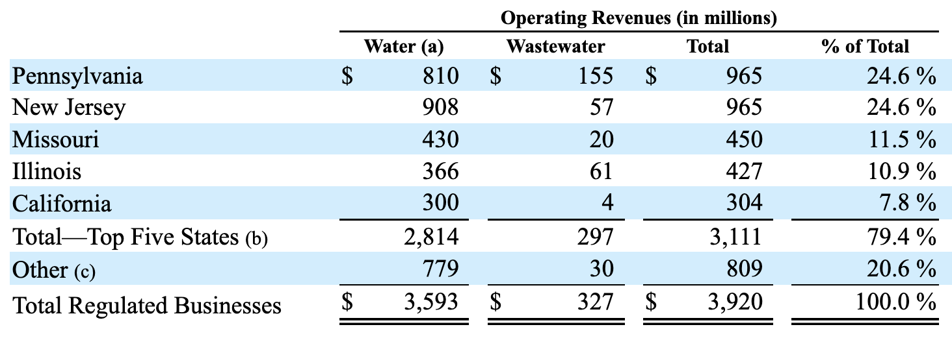
No thead tags in HTML
Multi-line headers
No HTML structure for column index
Semantically different table structures
(e.g., transposed tables)

